Slide 1
3-1 Designing a Level
5CM503 Virtual Environment Development
Dr Patrick Merritt
(Special thanks to Jon Pledger for the pictures and information)

Slide 2
Contents
Blockout

Slide 3
Blockout
Levels with cubes

Slide 4
What is a blockout?
A minimal representation of the gameplay environment.
Entirely composed of primitives
Designed to give a basic structure to the environment.
Platform for basic implementation of the gameplay
Refined later into the greybox.

Slide 5
Why do a blockout?
Allows a fail-fast approach. We can throw 10 blockouts away and have not invested any time.
Big changes can be made without wasting significant effort on high-quality assets.
Creates a platform to start testing gameplay right away.

Slide 6
Why do you need to learn to blockout?
This is an artist’s job, right?

Slide 7
Why do you need to learn to blockout?
This is an artist’s job, right?
WRONG!

Slide 8
Why do you need to learn to blockout?
This is an artist’s job, right?
WRONG!
If you can make a basic shape for something, you can start testing.
The artist can then make a more detailed representation later.
If you are sitting saying, I cannot do this as I am waiting for X from an artist. You are doing it wrong, knock up a primitive model.
Or a simple model, but that comes in graphics 2 ;)

Slide 9
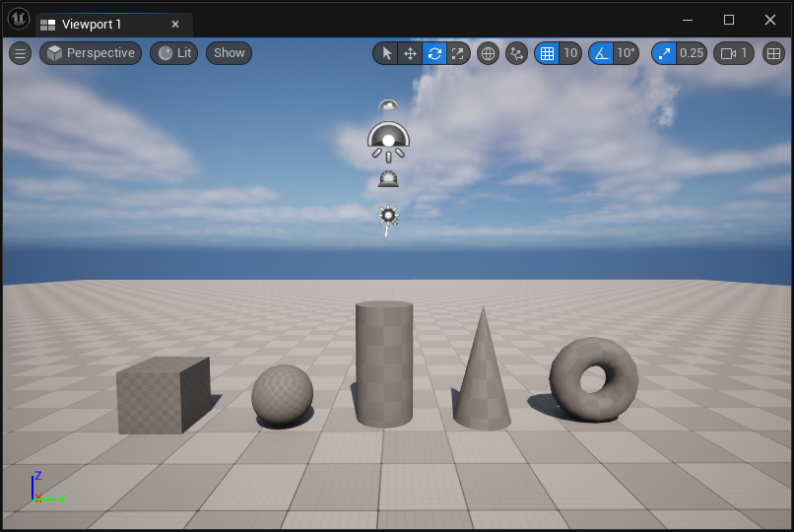
What’s a primitive?
Primitives are simple geometric shapes.
Any basic drag-and-drop shape from the create menu.
The arrow is pushing it in my opinion…
No editing of shapes!
Using these we create basic forms to represent the level.

Slide 10
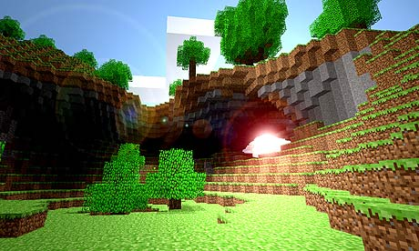
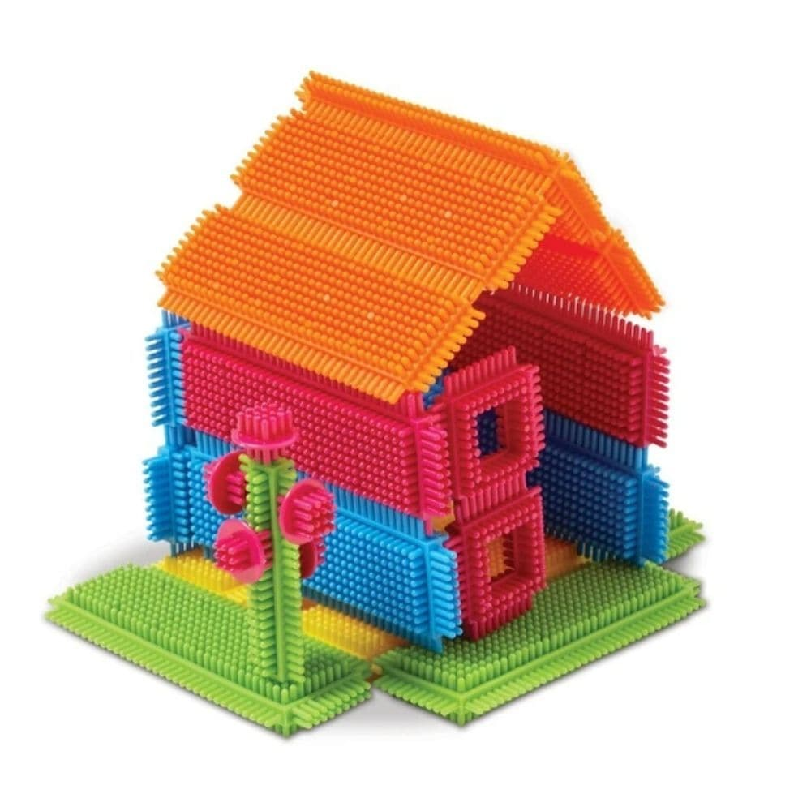
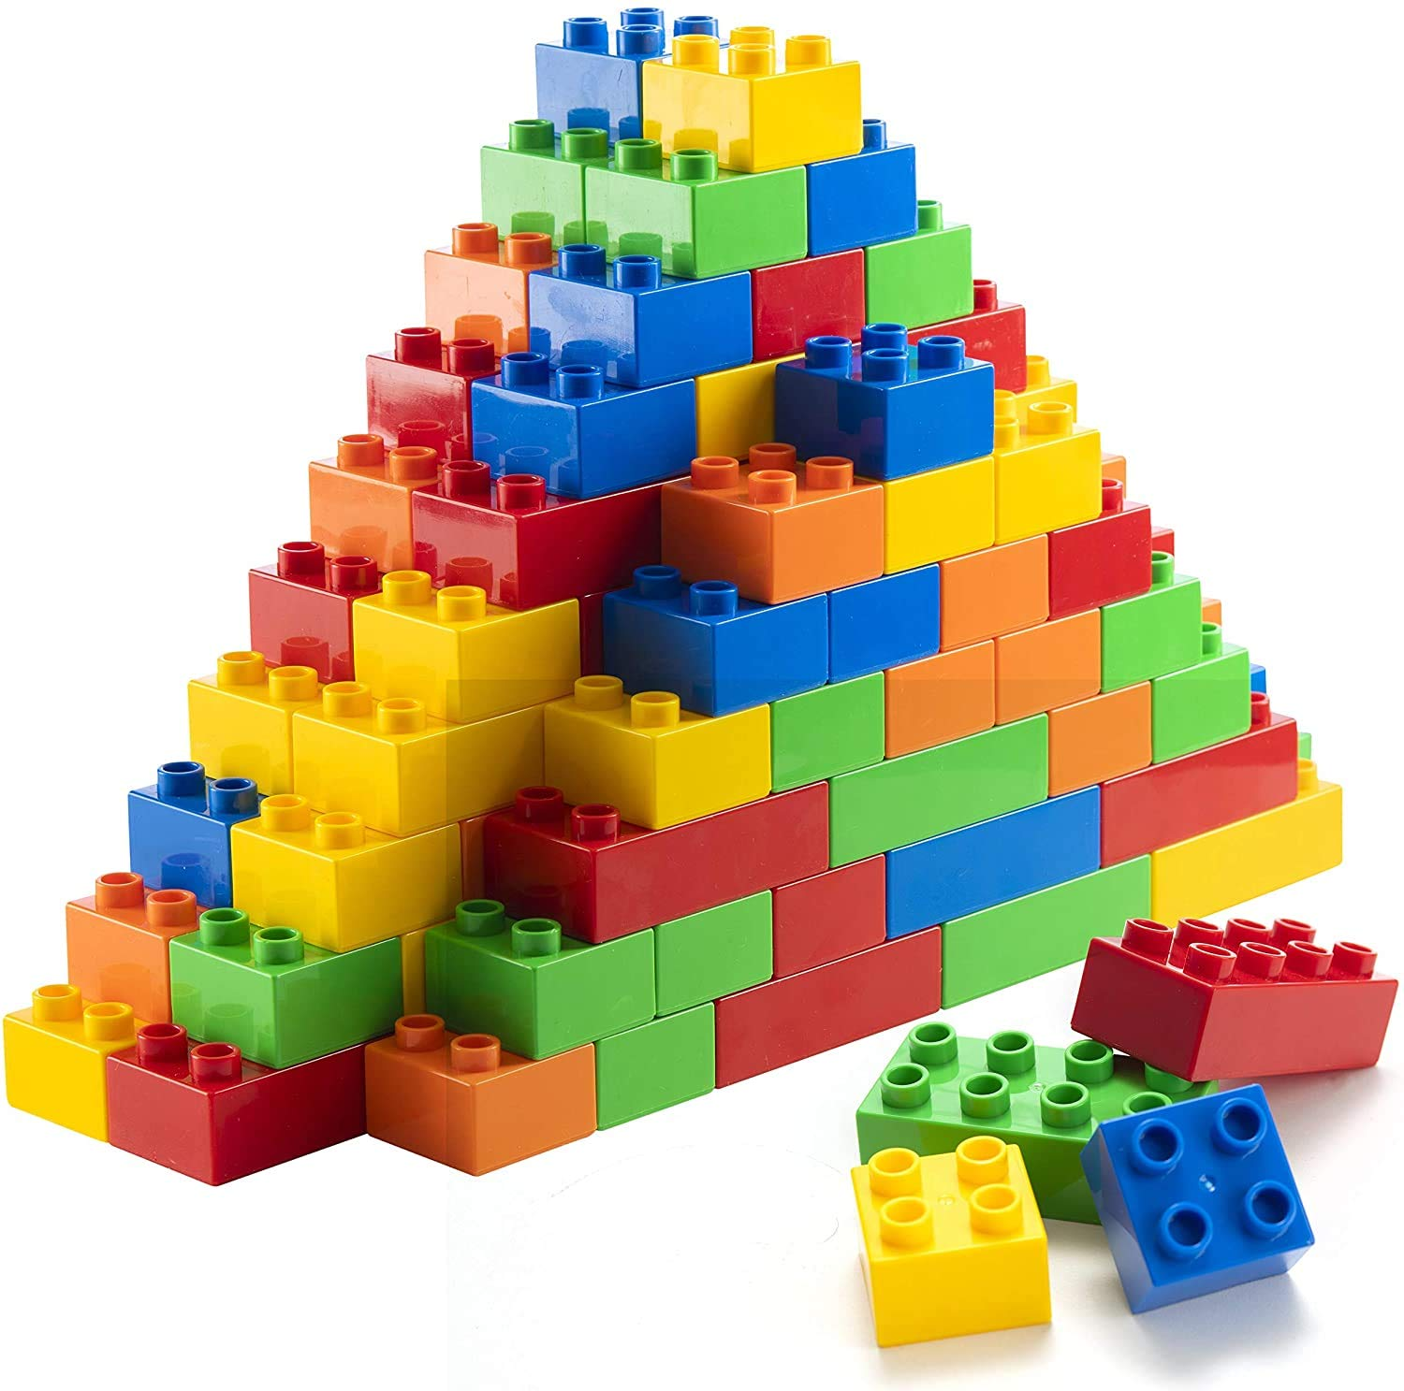
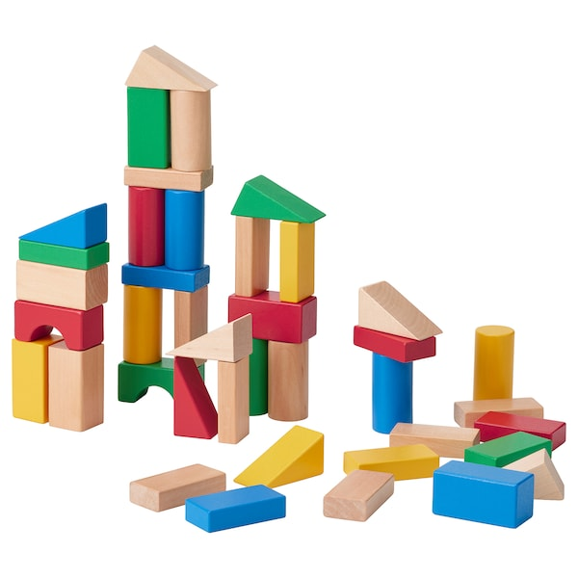
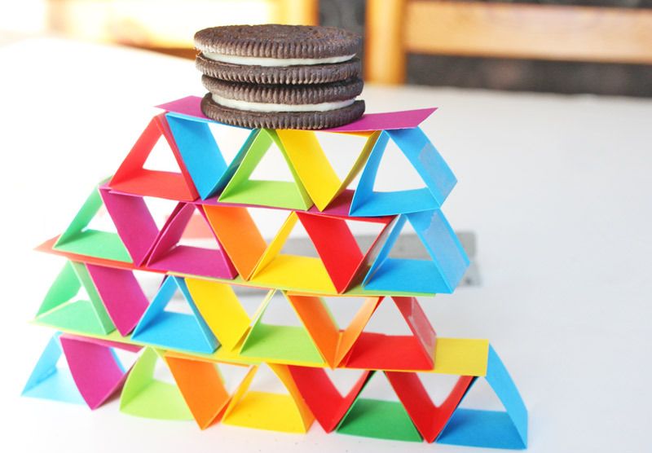
Good news you have already done this!

Slide 11
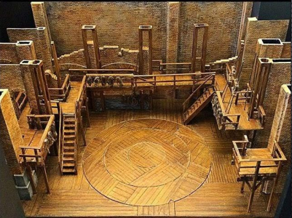
Similar process to set design
Create basic forms to represent the core framework of the “set”
We can then add more detail iteratively to move towards the final level design.

Slide 12
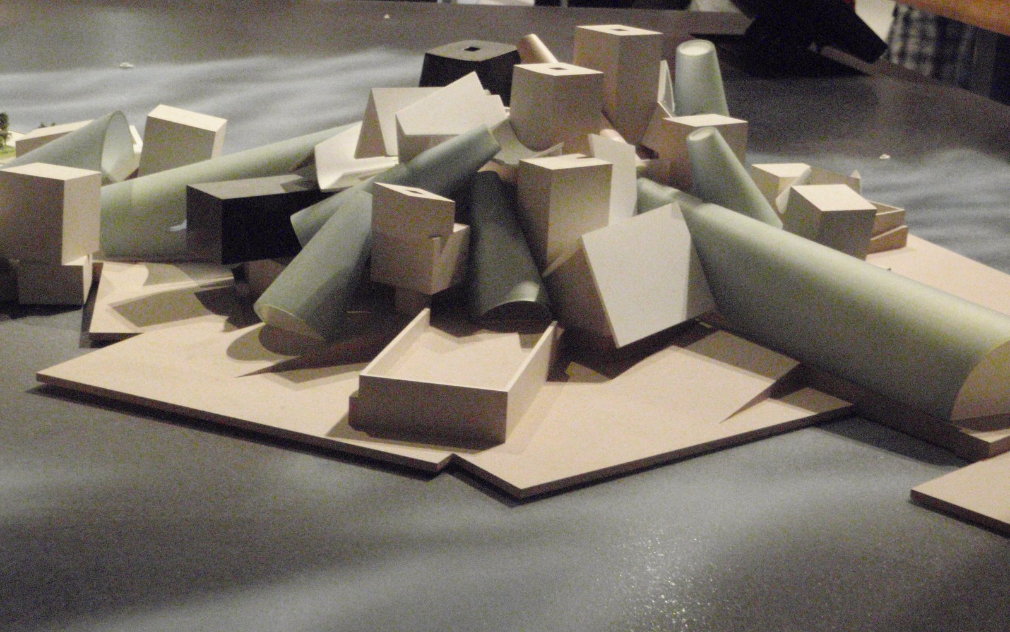

Slide 13


Slide 14
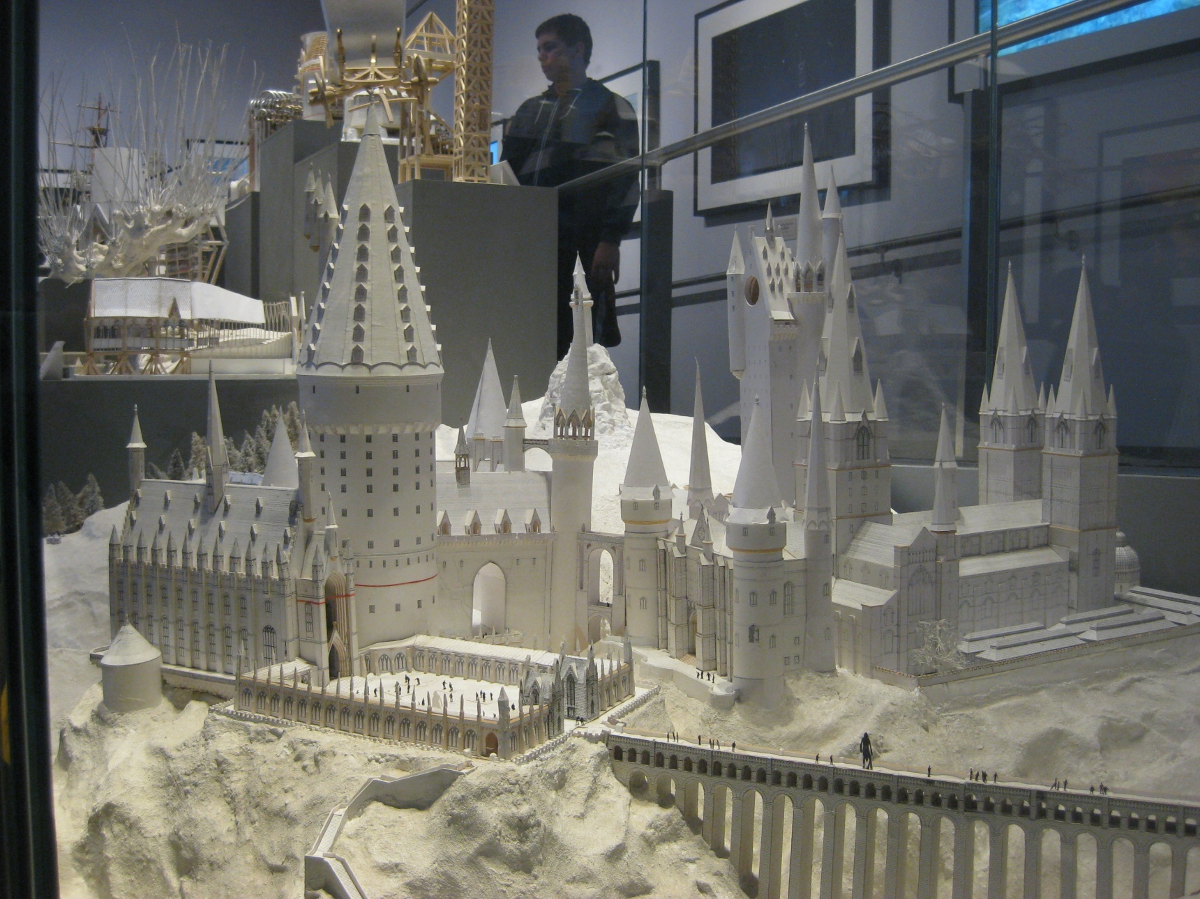

Slide 15
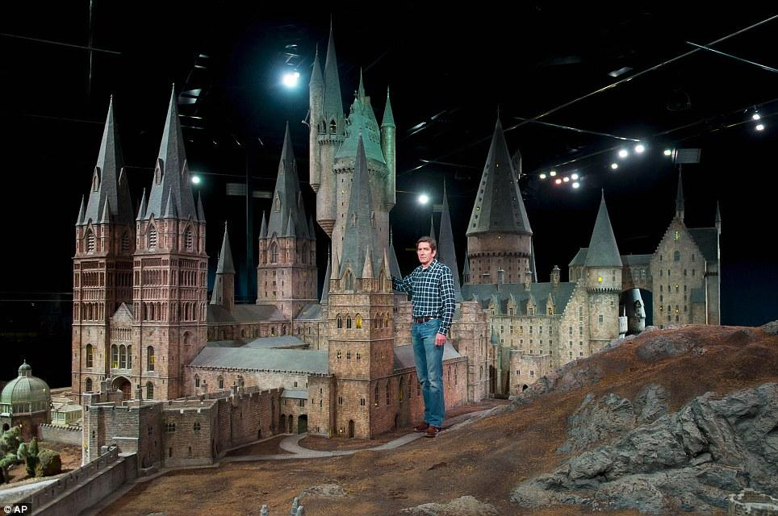

Slide 16
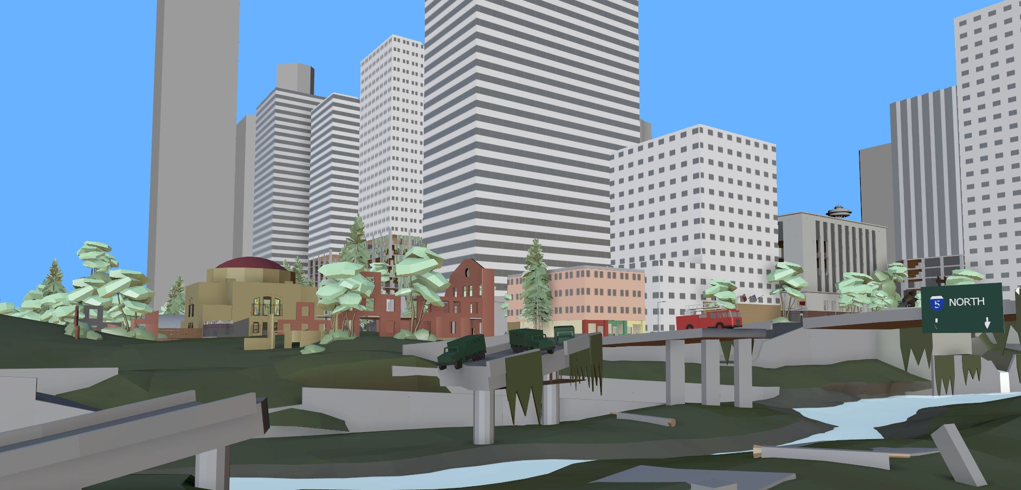

Slide 17
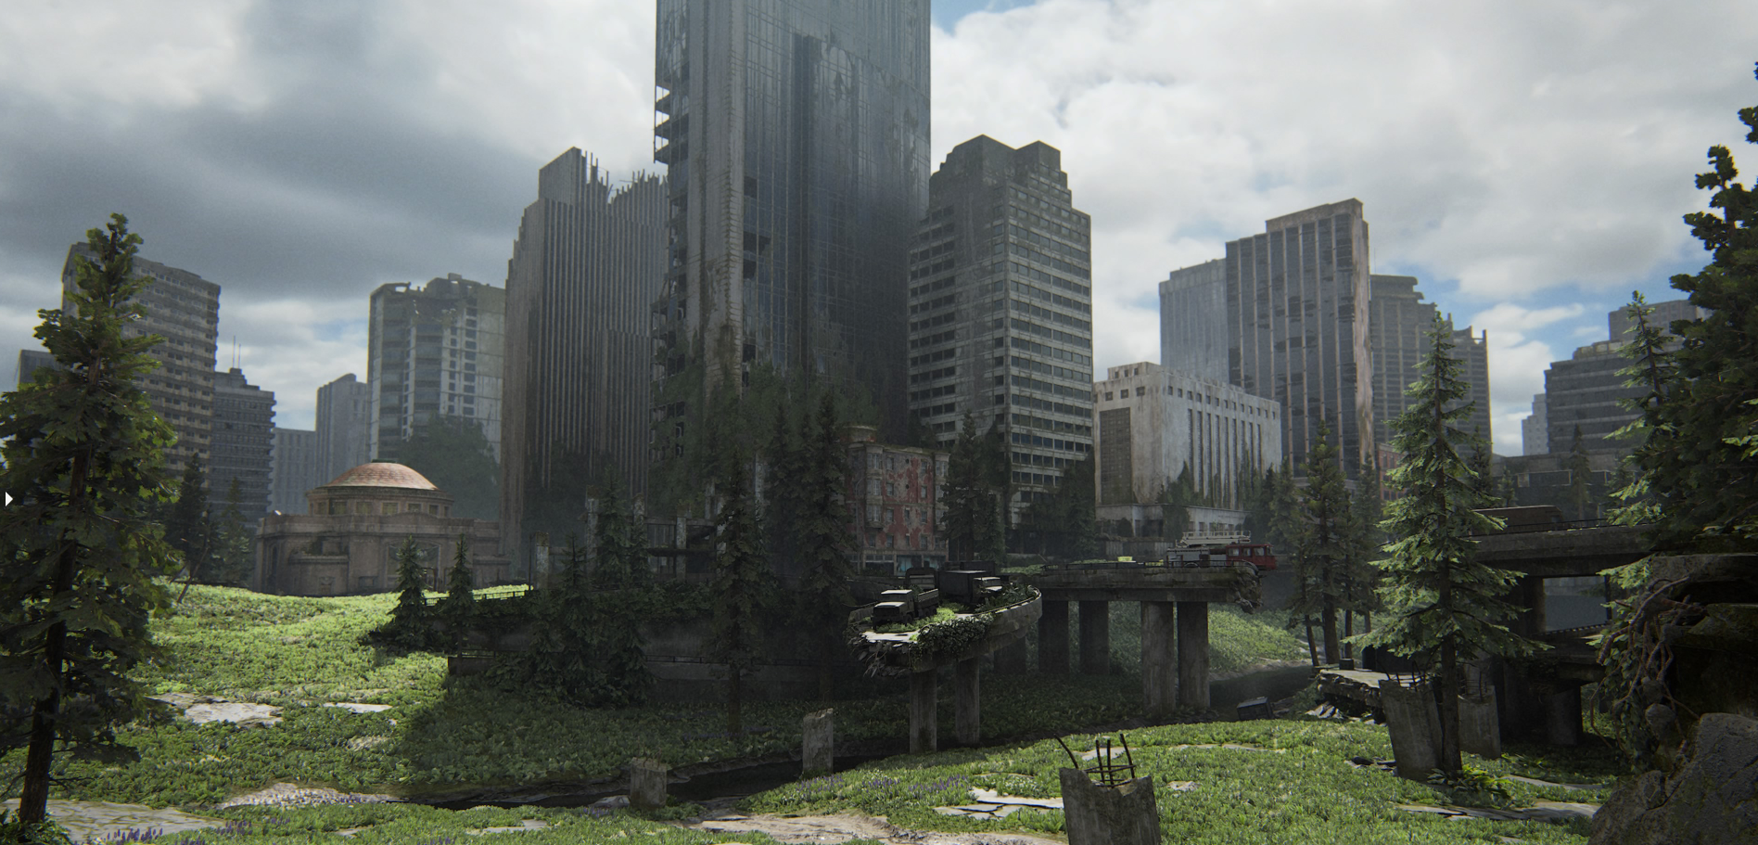

Slide 18
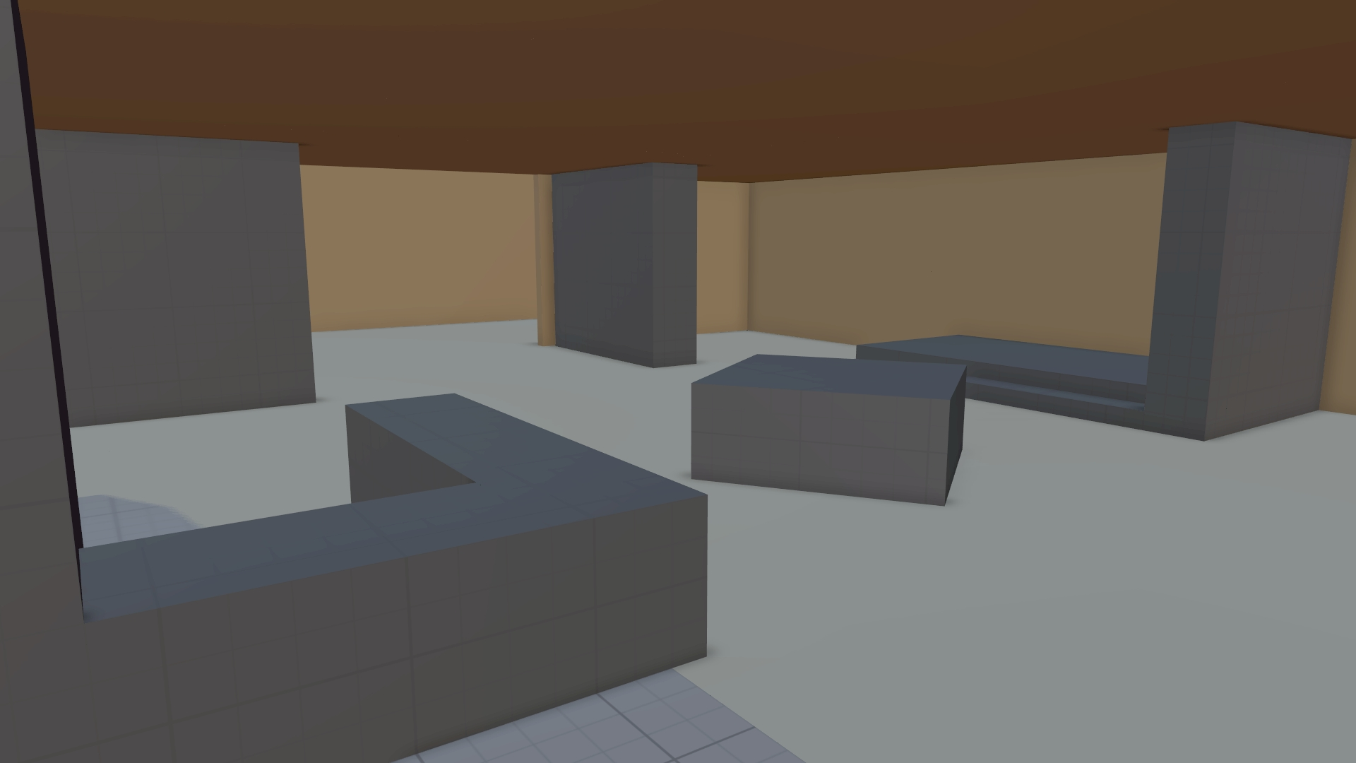


Slide 19
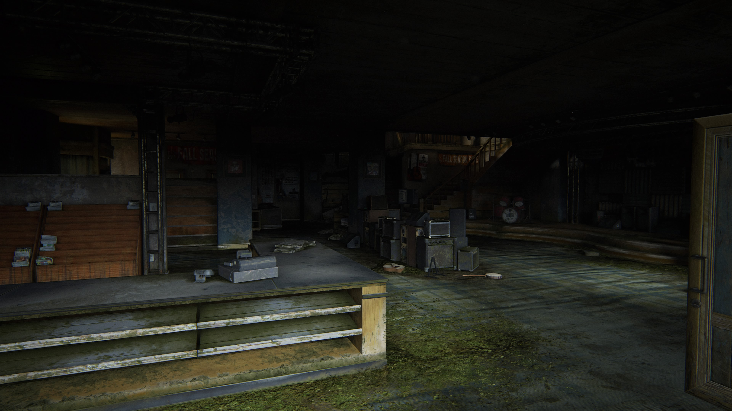

Slide 20
So how do I do this?
Quickly!
Seriously don’t spend huge amounts of time just block the space out.
Mistakes are fine but there's a few things to pay attention to

Slide 21
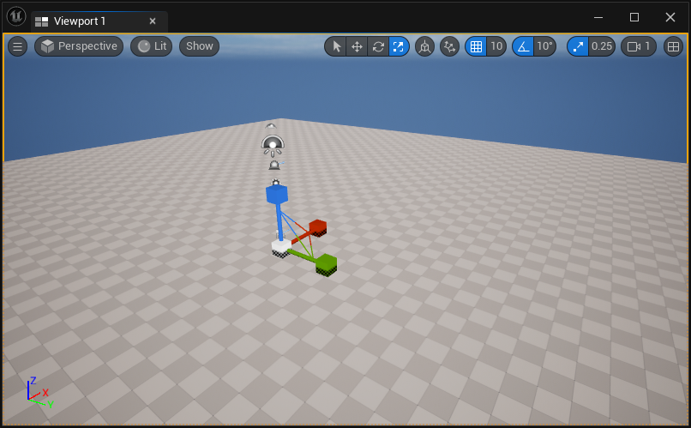
Turn on the snap!

Slide 22
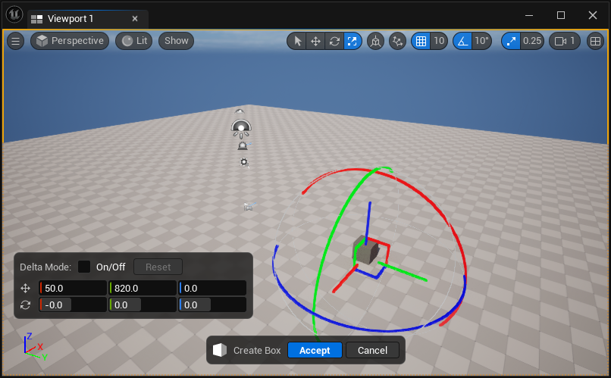
Snapping helps align things correctly

Slide 23

Not a big deal right?

Slide 24
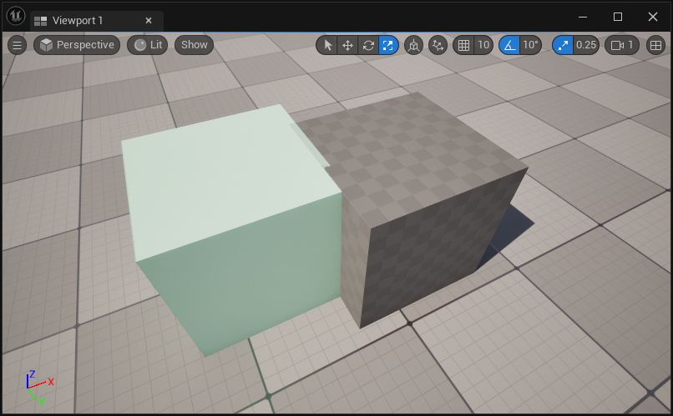
No Snap =(

Slide 25
Z fighting…

Slide 26
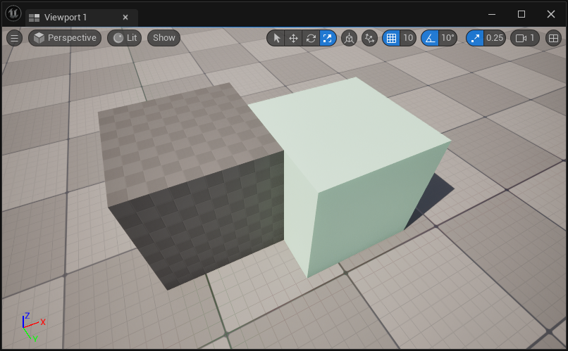
With Snap ☺

Slide 27
Scale
Everything must be scaled “reasonably”
Google real life sizes for a good starting point.
At this point adjustments can be made, but the closer you are the easier it is.
Drag out a character mesh to scale things.
If it’s not available create a scaling tool representing a character!
By default, characters are 180cm tall.
Paint it pink!
Pink things are meant to be removed later.

Slide 28
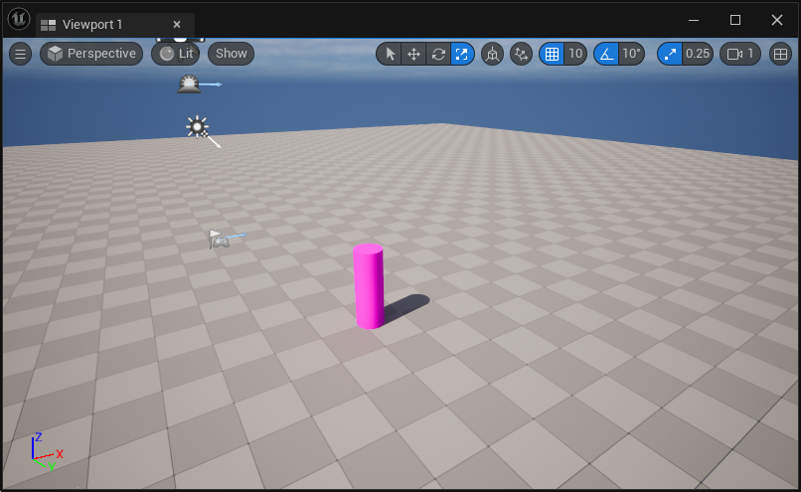
With this…

Slide 29
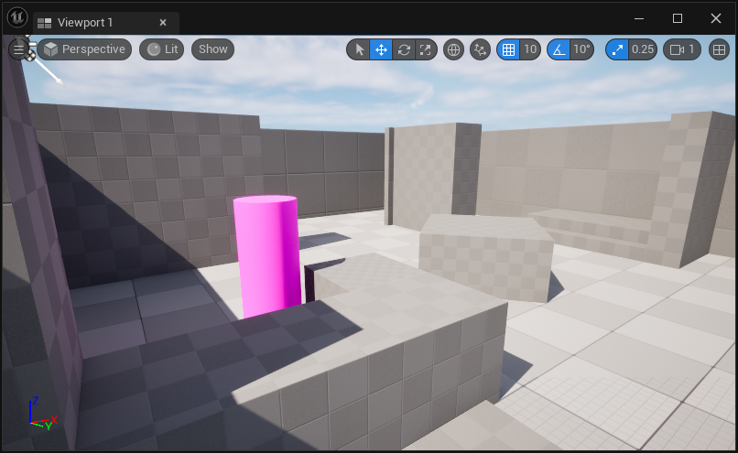
You can get this

Slide 30
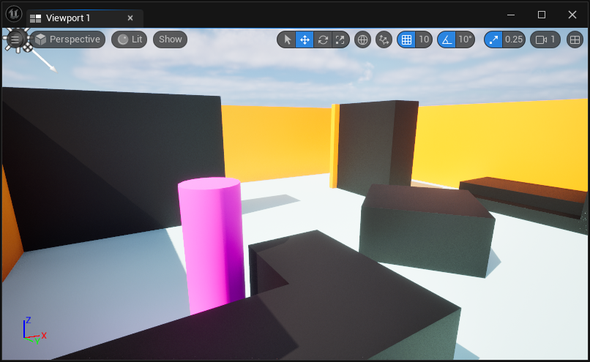
You may also want to add simple colours.

Slide 31
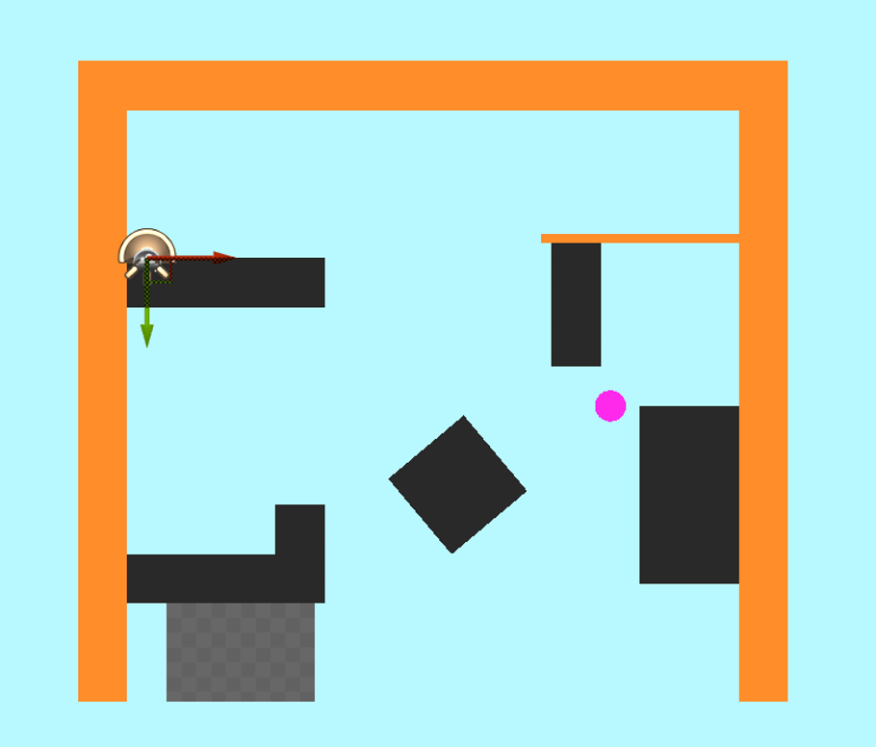
Once finished…
Set the camera to a top-down view.
Take a screenshot.
Use it to plot the path through the level

Slide 32
Once finished…
Set the camera to a top-down view.
Take a screenshot.
Use it to plot the path through the level
Quick and easy ☺
2
3
1
4

Slide 33
Once finished…
Set the camera to a top-down view.
Take a screenshot.
Use it to plot the path through the level
Quick and easy ☺
Don’t forget to remove the scaling actor!
2
3
1
4

Slide 34
This takes practice and imagination
You don’t need to be perfect…
Its fine to change your mind and adjust things
Its also a good idea to name objects as to what you think they are…
Makes the replacement process easier.

Slide 35
https://cdn.artstation.com/p/video_sources/002/168/810/chapel-progress-render-01.mp4

Slide 36
Homework
Go block out a level.
Give it a go, standard process have a go bring it in, and we can review it.
Keep it up. Work now is work you don’t have to do later.

